Slide 1
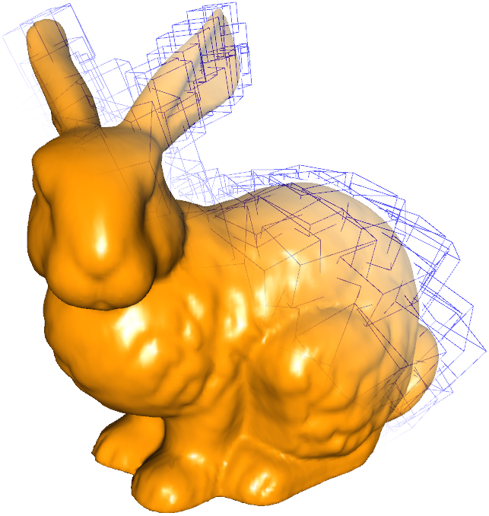
Optimizing Collision Detection based on OBB
Trees Generated with a Genetic Algorithm
E. Ramírez, H. Navarro,
R. Carmona, J. Dos Ramos
hector.navarro@ciens.ucv.ve
Universidad Central de Venezuela

Slide 2
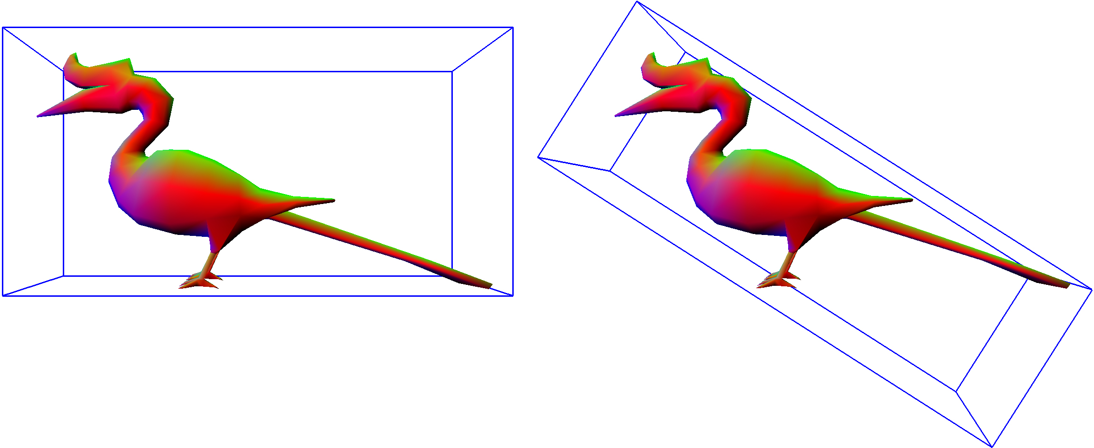
Introduction
Collision detection is a very important field in computer graphics
Hierarchical CD techniques are widely used
Performance of hierarchical techniques depends heavily on accurateness of the bounding volume

Slide 3
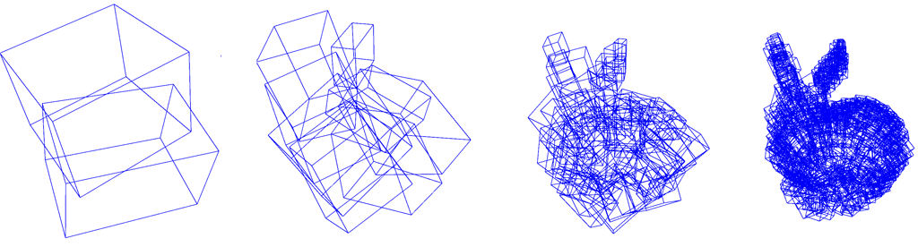
Collision Detection
Checking, if, when and where two or more objects of the scene have collided
Improves realism on the scene
Hierarchical methods decompose objects in bounding volumes recursively

Slide 4
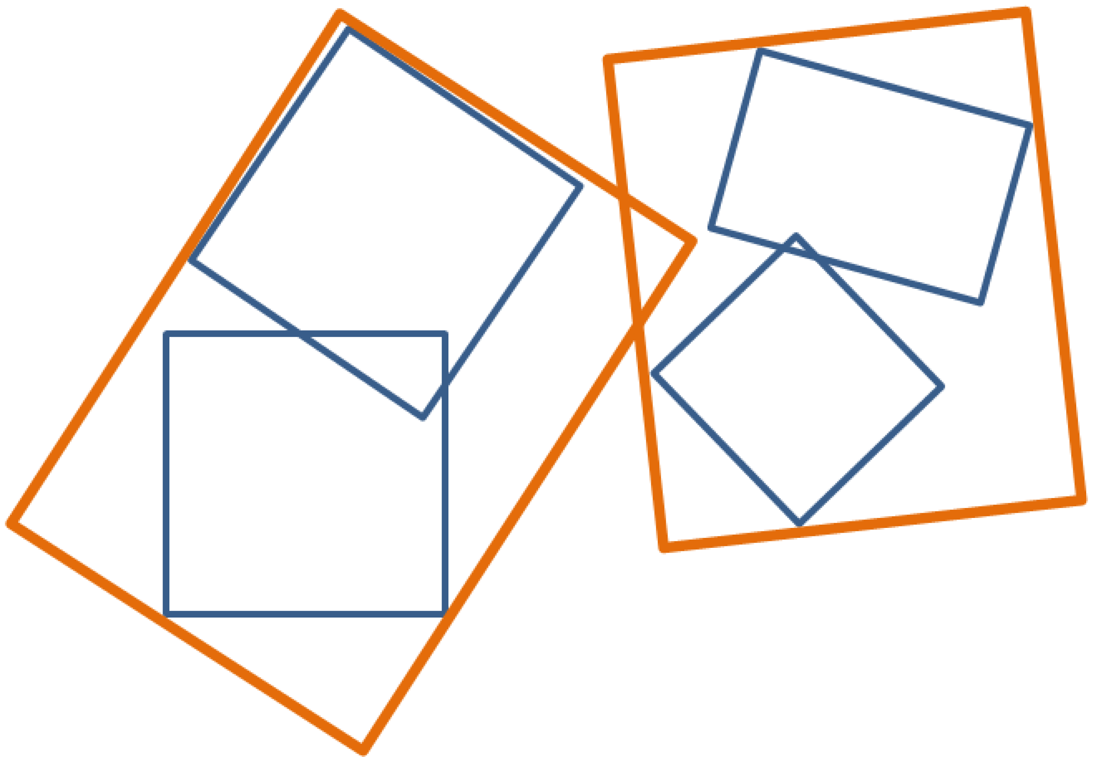
Collision Detection
Consider the following 2D example:
In order to check for collisions, at first the highest level bounding volumes (orange) must be intersected
Since those bounding volumes collide, it is necessary to check for collisions at the second level (blue)
At this level a collision is discarded, because there is no intersection between bounding volumes of different objects

Slide 5
OBB Trees
Some desirable features of OBB trees are:
Minimal number of triangles (N) on each leaf, because checking collisions between two leaves is a O(N²) algorithm
The tree should be as balanced as possible in order to keep the collision detection of O(Nlog₂(N))
Current methods for building OBB trees are statistical and their results tend to depend on concentrations of vertexes of the object

Slide 6
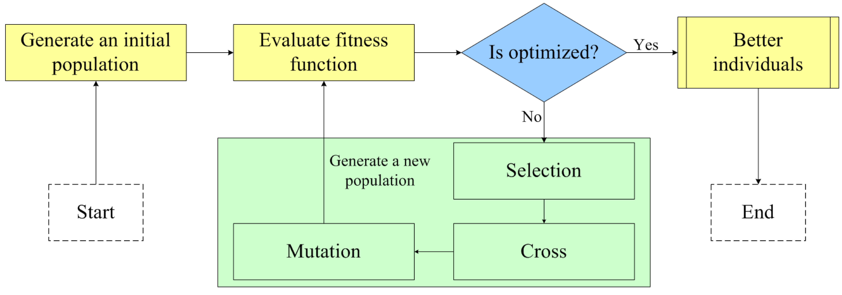
Genetic Algorithms

Slide 7
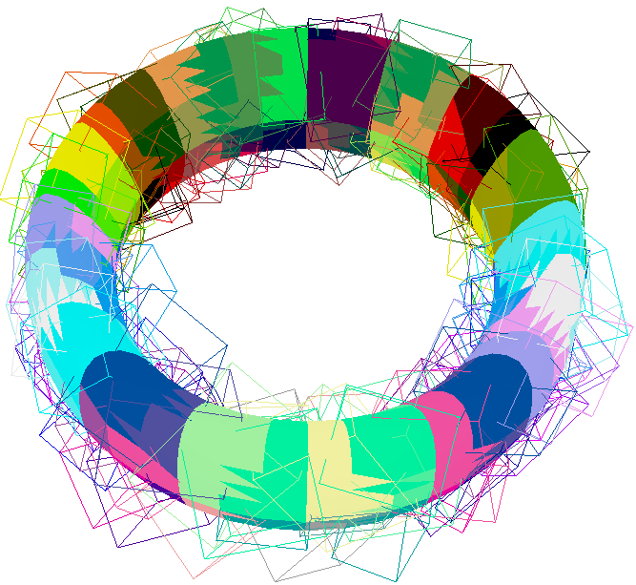
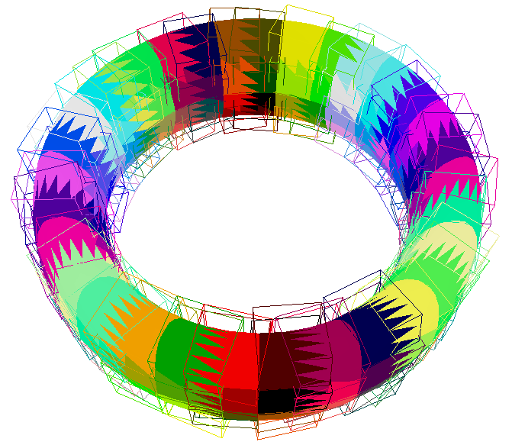
Approach
Covariance method
Our method

Slide 8
Chromosomal Representation
OBBs can be represented specifying its orientation
Given an orientation the minimal bounding box that encloses the object can be easily computed
We use quaternions to represent orientations as they are compact and have important mathematical properties
A quaternion is a tuple q = (x, y, z,w) which represents a rotation around an arbitrary axis

Slide 9
Chromosomal Representation
Each component of the quaternion needs to be represented as a floating point
We use a 16 bit fixed representation for each component of the quaternion
Range for x, y and z is [−1, 1], with a precision of 2/2¹⁶≈3.05x10⁻⁵
Range for w is [0, 360], with a precision of 360/2¹⁶≈5.49x10⁻³

Slide 10
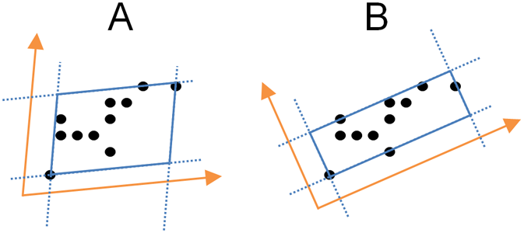
Chromosomal Representation
The quaternion is used to rotate the basis axes (1, 0, 0), (0, 1, 0) and (0, 0, 1), obtaining a new set of axis which will be used to build the OBB

Slide 11
Genetic Algorithm Parameters
Generation Gap
Fitness function
Selection method
Cross over operator
Mutation
Generations
20% of population is replaced
1/V, V is volume of the OBB
Roulette wheel
Single point with p=0.8
Probability p=0.03
150

Slide 12
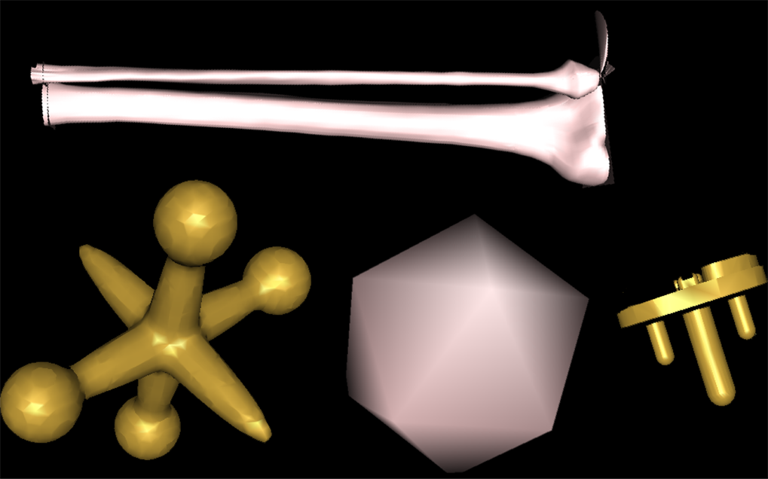
Test and Results

Slide 13
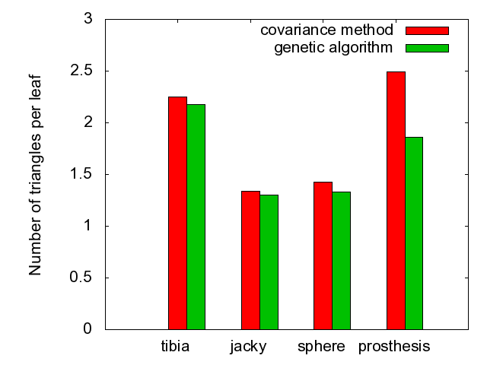
Test and Results

Slide 14
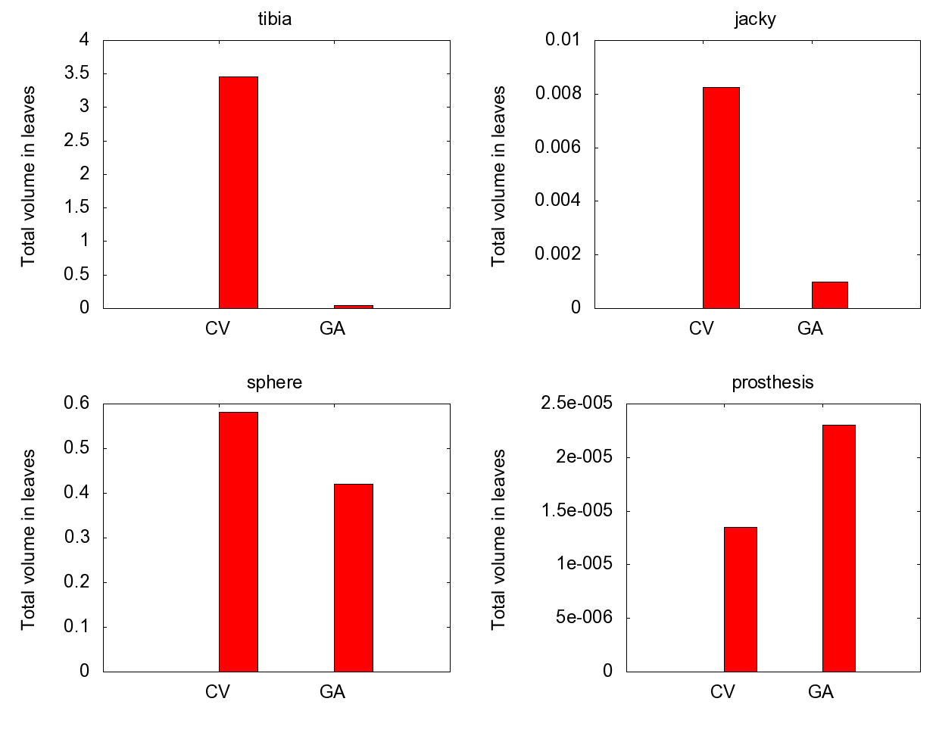
Test and Results

Slide 15
Test and Results
Four scenes were defined for collision detection timing
Scene
1
2
3
4
First Object
jacky
jacky
prosthesis
tibia
Second Object
sphere
tibia
tibia
tibia
T-T pairs
132,080
149,659,848
223,764,588
513,566,244

Slide 16
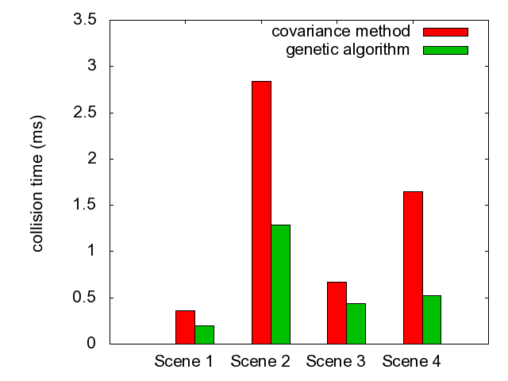
Test and Results

Slide 17
Conclusions
The proposed GA for generating oriented bounding boxes achieves better results than the covariance method
The volume of the resulting OBBs using GA is in average lower than the volume of the OBB created with the covariance method
Time required for detecting collisions is between 40 and 80% lower
The GA takes more time to build the OBB tree than the covariance method, but it has to be built only one time

Slide 18
Future works
Recalculate the OBBs when the geometry of the model is slightly modified, so the GA method can be used on dynamic scenes
Allow the GA to choose the axis along which each OBB will be divided
Use multithreading in both the genetic algorithm and the collision detection algorithm in order to reduce the required time for these processes

Slide 19
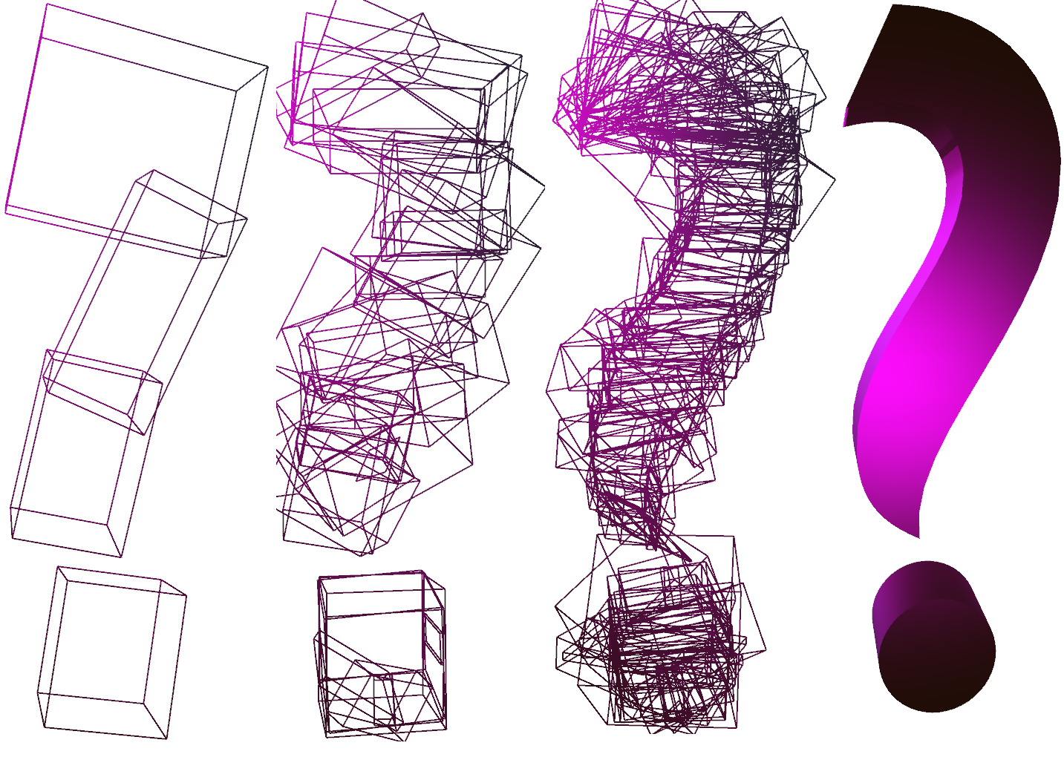


Questions
http://ccg.ciens.ucv.ve
{esmitt.ramirez,hector.navarro,rhadames.carmona}@ciens.ucv.ve

